Slide 1


Sovereign Bank Service Portal, AI/GenAI Strategy and Virtual Agent Strategy
Vaibhav Maheshwari
Architect @ServiceWow
ServiceWow

Slide 2
Project Goals and Challenges
Service Portal Strategy
AI and Generative AI Strategy
Virtual Agent and Chat functionality
Next Steps & Key Takeaways
Agenda

Slide 3





Addressing Sovereign Bank's Needs
Omnichannel Support
Unified customer support desk
Contact Center
Consolidated communication hub
GenAI Productivity
Enhanced agent efficiency
Process Automation
Enterprise-wide simplification

Slide 4



Current Challenges
Improve Metrics
Decrease MTTR, increase deflection
GenAI Pilot
New implementation requiring testing
Multiple Channels
Web, phone, email, various portals

Slide 5
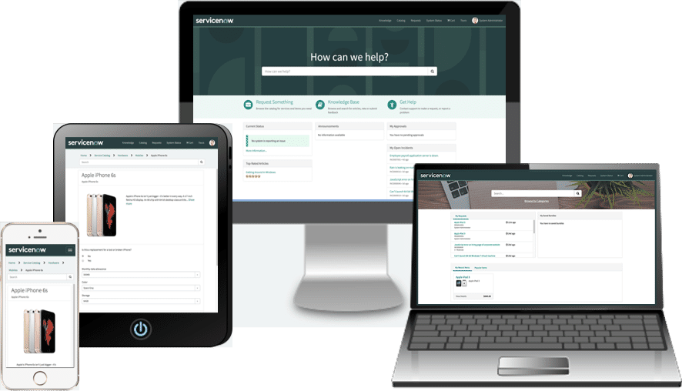
Service Portal: Your Self-Service Hub
User-Friendly Experience
Mobile-first design for anywhere access
Consolidated Access
One-stop shop for apps and services
Modern Interface
Consistent UI across all touchpoints

Slide 6


Service Portal: Key Features and Technologies
Framework
Pages, Widgets, APIs
Technologies
HTML, AngularJS, CSS, Bootstrap
Widgets
Reusable self-service components

Slide 7








Service Portal: Delivering Value
Portal Consolidation
User Experience
Reduces multiple entry points
Improves adoption rates
Development Tools
Request Deflection
Debugging, diagnostics, analysis
Frees agent capacity

Slide 8
AI and GenAI: Enhancing Service
Gen AI
ServiceNow AI
AI Definition
Creates content (text, images)
Predictive Intelligence
Machines with human-like intelligence
Document Intelligence
Task Intelligence
Now Assist

Slide 9
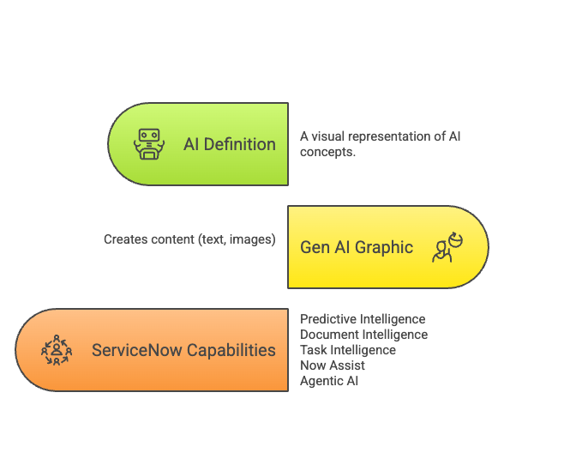

AI and GenAI: Enhancing Service

Slide 10
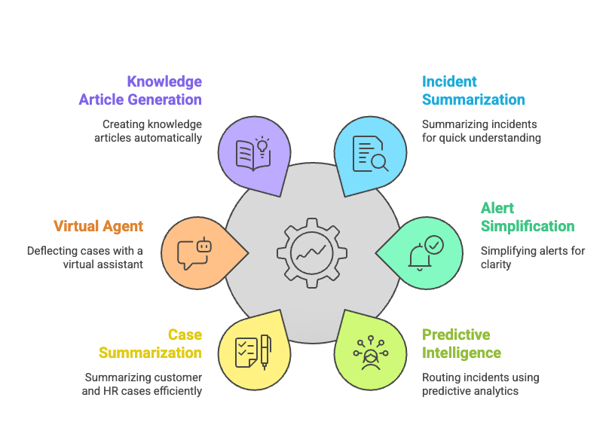
GenAI: MVP Recommendations

Slide 11



Generative AI: Release Roadmap
Phase 1
Phase 2
Phase 3
Focus on quick wins
Virtual Agent expansion
Flow / Playbook Generation
Code Generation Implementation
Advanced Predictive Intelligence
Document Intelligence Capabilities
Notes:
My personal suggestions for Phases:
Phase 1 – Quick wins, Virtual Agents FAQ and Initial Chatbot automation
Phase 2 – (everything you have plus...) Case routing, ticket classification
Phase 3 – Gen AI-driven insights, predictive analytics (might be the same as you already have)

Slide 12








Virtual Agent: 24/7 Self-Service
Self-Service Interactions
NLU Intent Recognition
Automated issue resolution
Smart conversation understanding
Service Portal Integration
Live Agent Handoff
Connected experience
Seamless escalation process

Slide 13
Measuring Success: Key Metrics
85%
40%
Portal Adoption
Virtual Agent Deflection
Target user engagement
Reduced support tickets
30%
25%
MTTR Improvement
Productivity Gain
Faster issue resolution
Agent efficiency increase
Notes:
Do we have any source to add as a small url to support these numbers?

Slide 14





Next Steps
Confirm Requirements
Finalize design specificationswork
Begin Development
Service Portal and Virtual Agent build
Initiate Gen AI Pilot
Test key functionality
Establish Governance
Responsible AI framework

Slide 15




Key Takeaways
MODERNIZED EXPERIENCE
AI AUTOMATION
24/7 SELF-SERVICE
MEASURED SUCCESS

Slide 16




Thank you
www.servicewow-consultancy.com
Notes:
That concludes my presentation. Thank you for your time. I’d be happy to take any questions.

